Slide 1





Slide 2
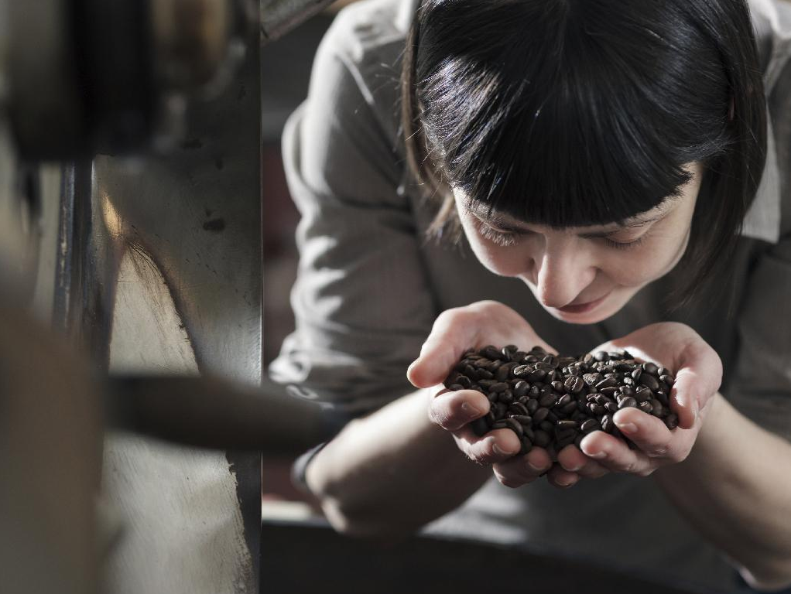

BREWING FOUNDATION

Slide 3


HOUSEKEEPING
Schedule
Bathrooms
Please take phone calls outside

Slide 4
OBJECTIVES
Cover history of brewing
Identify key research
Review European Coffee Extraction Preferences
Review SCAE Water Chart

Slide 5
SCAE 2013
Coffee extraction preference study
Research supported 1960s Coffee Brewing Centre findings
Supports Gold Cup range of 18-22% extraction yield
Notes:
Supported 18-22% as extraction range preferred by most people
Showed preference towards 20-22% with 43.8% of all participants preferring in that range

Slide 6
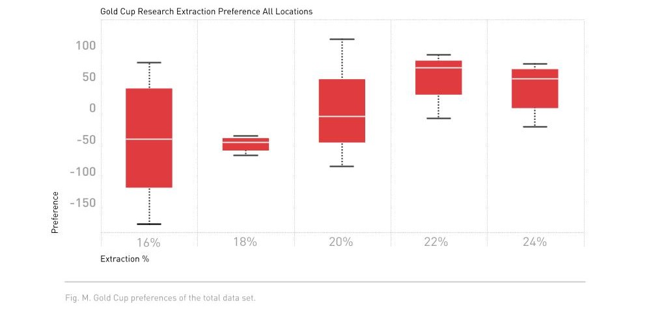
Notes:
Line in middle is median data, red box edges are 25th and 75th percentile.
Most positive preference is at 22% extraction.

Slide 7
SCAE WATER CHART 2016
Water quality study
Outlines optimum balance for brewing water
Establishes “Measure, Aim, Treat” procedure
Recommends particular water chemical makeup range

Slide 8
ALKALINITY
Acid buffering capacity
Measured as CaCO₃ concentration (ppm)
Should be between 40-75 ppm CaCO₃
pH should fall within 6.5 to 8
Notes:
CaCO₃ is equivalent to HCO₃⁻ in solution

Slide 9
TOTAL HARDNESS
The sum of Magnesium and Calcium in equal concentrations. (Mg²ᐩ and Ca²ᐩ ions).
Scale from hardness is limited to carbonate hardness
Carbonate hardness = Alkalinity or Total hardness (whichever is lower)
Should be between 50-175 ppm CaCO₃
Notes:
CaCO₃ is equivalent to HCO₃⁻ in solution

Slide 10
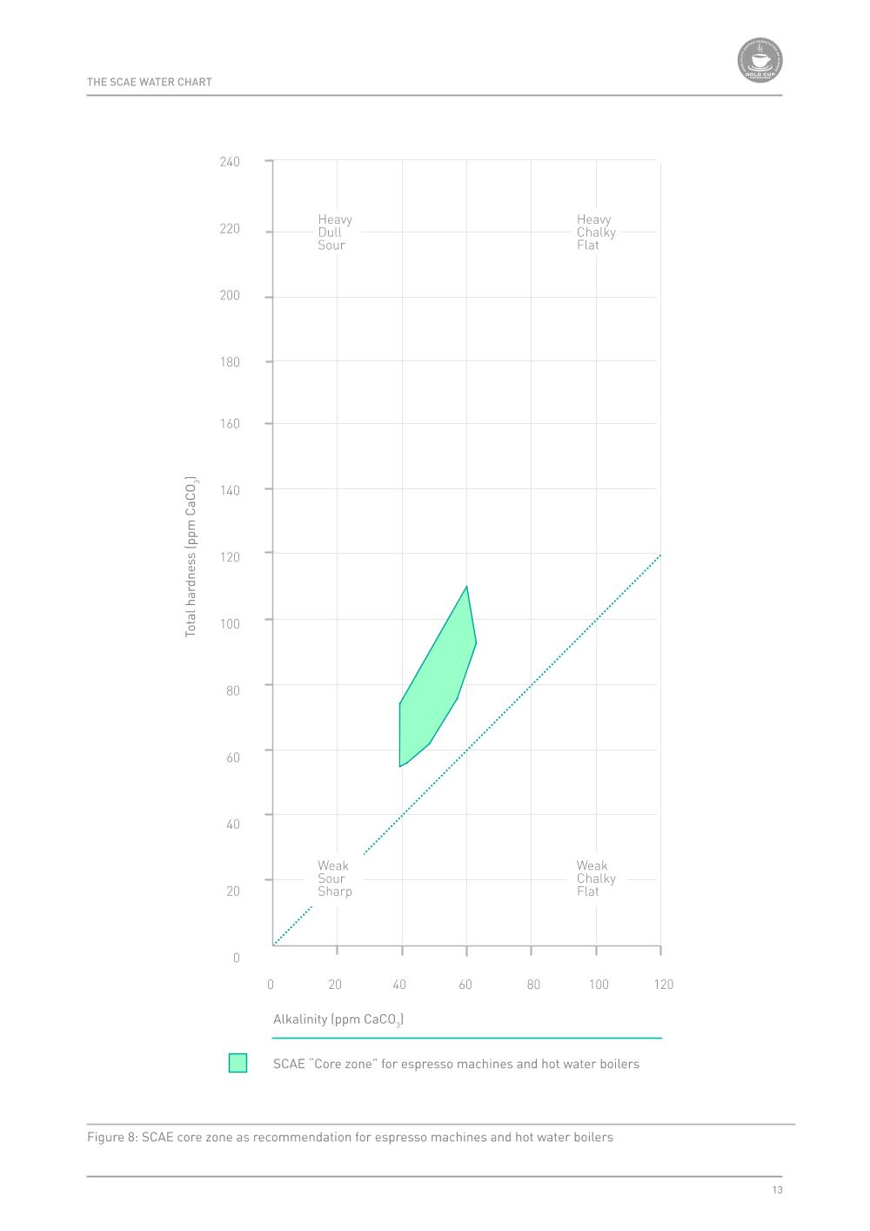

Slide 11
WATER QUALITY
Correct Hardness Range: 50-175 ppm CaCO₃
Correct Alkalinity Range: 40-75 ppm CaCO₃
Activity! Brew and taste waters inside and outside of the “core zone” of water quality.

Slide 12
OBJECTIVES
Brewing Process
Stages of Extraction
Tasting Extraction Differences

Slide 13
BREWING PROCESS
CO₂ gas released
Extraction of water soluble compounds
Different solubles extract at different rates

Slide 14
BREWING REQUIREMENTS
High Quality Water
Choose a Brewing Method
Grinding Fresh with a Quality Grinder
Appropriate Filtering Method
Correct Coffee:Water Ratio
Proper Technique

Slide 15
EXTRACTION PROCESS
Maximum possible extraction is between 24-35% (~30%)
1st group solubles: Acids
2nd group solubles: Sugars, Amino acids
3rd group solubles: Polyphenols
Activity! Tasting stages of extraction
Notes:
Tasting Brew Split into 3 parts, parts 1 & 2 combined, complete brew

Slide 16
IDEAL EXTRACTION
Generally accepted ideal extraction range is 18 - 22%
Changing extraction affects flavor qualities
Activity! Tasting different extraction points

Slide 17
OBJECTIVES
Measuring TDS
Tasting Strength Differences
Charting on Brewing Control Chart
Calculating Extraction %

Slide 18
MEASURING TDS
Using Refractometer
Measures light refraction through liquids
Tells us soluble concentration of the brew
We can calculate extraction using TDS

Slide 19
STRENGTH
Concentration of solubles in brewed coffee
Affects flavor intensity
Should be above 1.15 TDS
Activity! Tasting different concentration points

Slide 20
BREWING CONTROL CHART
Tool for illustrating relationship of Strength and Extraction
Can be used for many brewing methods
Activity! Brew and chart a a filter coffee and espresso. Then calculate Extraction Yield.

Slide 21
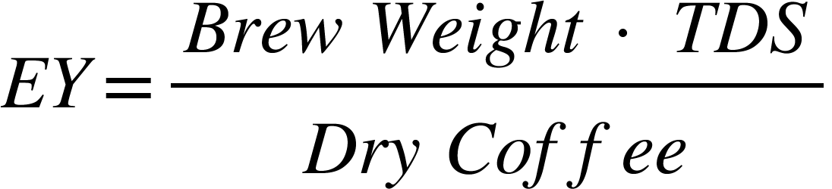
EY% FORMULA

Slide 22
OBJECTIVES
Explore Water/Coffee Ratio
Explore and Chart grind size impact
Explore changes in brew time (contact time)

Slide 23
COFFEE TO WATER RATIO
Measure ratio in grams to grams
Minimum ratio is 1:20 of dry coffee to water
SCA Gold Cup Ratio is 1:17.5 (55g/L)
Activity! Sample brews at different ratios
Notes:
Reference brewing chart. Explain why certain ratios are less likely to brew quality cups.
Brew 43.77g:L, 56.65g:L, 74.08g:L

Slide 24
GRINDING COFFEE
Freshly ground using a burr grinder
Flat/Conical Burrs, Roller grinders
Particle distribution and grind analysis

Slide 25
GRINDING COFFEE
Freshly ground using a burr grinder
Loss of volatiles increased by grinding
Oxidation rate increased by grinding
Coffee should be used within 3 minutes of grinding
Notes:
Grind coffee sample

Slide 26
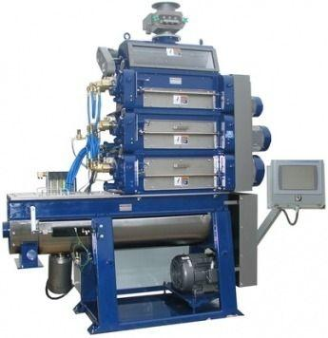
GRINDING COFFEE
Flat/Conical Burrs, Roller grinders
Flat: Unimodal grind distribution, used for espresso or filter brewing
Conical: Bimodal grind distribution, primarily used for espresso brewing
Roller: Large throughput grinding

Slide 27
GRINDING COFFEE
Particle distribution and grind analysis
Grinders have distribution of ground coffee particle sizes
LASER Particle Diffraction: Measures amount of light diffracted
Sieve: Ground coffee is sifted in to groups and weighed.

Slide 28
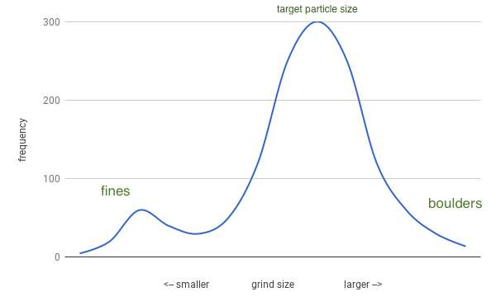
GRINDING COFFEE
Particle distribution and grind analysis
https://www.scottrao.com

Slide 29
CONTACT TIME
Longer contact time will result in more extraction
For filter(drip) methods, changing water delivery time will effectually increase contact time.
Different brew methods require different brew times and relative grind sizes
Activity! Brew and taste two brews at different contact times.

Slide 30
GRIND SIZE
Affects rate of extraction through change in surface area and change in flow rate
Activity! Brew and taste coffees with different grind sizes

Slide 31
OBJECTIVES
Explore water temperature impact
Explore impact of turbulence on extraction
Explore impact of roast development on cup profile
Explore impact of different methods for creating cold coffee

Slide 32
TEMPERATURE
Increasing or decreasing temperature will respectively increase or decrease extraction.
Recommended range: 195°F - 205°F / 92°C - 96°C
Activity! Brew and taste using 2 different temperatures.

Slide 33
TURBULENCE
Also called agitation
Increases extraction
Different methods:
stirring
increased water pulses
faster water flow
Activity! Brew and taste two brews with different amounts of turbulence.

Slide 34
ROAST DEVELOPMENT
Roasting affects final cup profile as well as extraction rate
Changes can occur during different phases of the roast
Activity! Taste coffee roasted to different degrees of development.

Slide 35
COLD BREWING COFFEE
Cold brewing vs. Cold Coffee
Cold brewing achieves extraction through lower temps and significantly longer contact time.
Activity! Taste cold coffee prepared through different brewing methods and ratios.

Slide 36
FILTER MEDIUMS
Filter type will affect qualities of brew
Paper
Filters most oils. Low flavor influence
Cloth
Filters most all oils. High flavor influence
Metal
Does not filter oils. No flavor influence
Activity! Brew with taste with each filter type.

Slide 37
REVIEW
What are two tools that can measure concentration?

Slide 38
REVIEW
What is the SCA recommended concentration range for alkalinity?

Slide 39
REVIEW
What is the maximum extraction range that can be achieved?

Slide 40
REVIEW
What would be the result of changing only water contact time?

Slide 41
REVIEW
What needs to be balanced to achieve an optimum brew of coffee?

Slide 42
REVIEW
How does a refractometer measure brew concentration?

Slide 43
REVIEW
What pH range for water does the SCA recommend?

Slide 44
REVIEW
What type of roast development would yield the lowest TDS, all other brewing parameters equal?

Slide 45
REVIEW
What is the minimum acceptable TDS for filter coffee? Or maximum water percentage?

Slide 46
REVIEW
What is the minimum recommended Coffee:Water ratio? What is the ideal ratio? Why?

Slide 47
REVIEW
What four sensory aspects are used to evaluate coffee?

